Slide 1


Slide 2

The NutriDono project
Initial data collection (Italy): October 2025 – August 2026;
13 distribution sites included from: CARITAS (7), CAIR (3) and ADRA (3);
1169 food parcels collected from a total of 251 beneficiary households: 1023 individuals, including 392 children.

Slide 3
Data from CARITAS Rome and Naples collected between October 2025 and August 2026

Slide 4
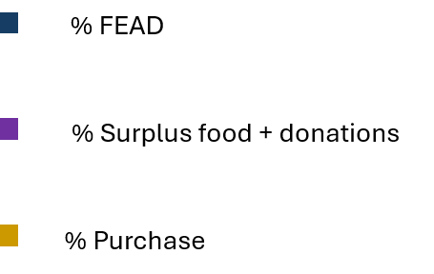
Data from CARITAS Rome and Naples collected between October 2025 and August 2026

Slide 5
Data from CARITAS Rome and Naples collected between October 2025 and August 2026

Slide 6


